Slide 1

DSC 530 Final Project
EDA on Bank marketing campaign and predictability of success
By: Matthew Litschewski
Bellevue University

Slide 2

Hypothesis : That it is possible using the variables in the dataset to fit a logistic regression model to predict a positive outcome.
The data consist of multiple variables but has been reduced to the five though most relevant to the question at hand. The variables are age, balance ( how much they have in the bank), education, employment, duration( how long they were engaged by a marketer), the campaign that was used and Y(the outcome) .
Variables:
Age: the age of the person
Balance: How much they have in the bank at the time the data was collected.
Education: Categorical – what level of education did they report having.
Housing: Did they have a loan with the bank( this was not used )
Duration: How long ( in sec) they were engaged with the campaign
Campaign: Which campaign were they given
Y: What was the outcome.

Slide 3
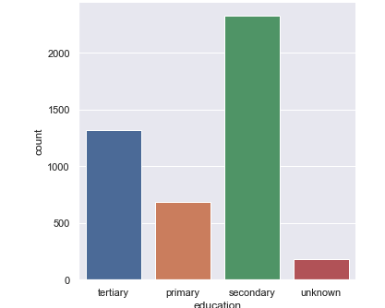
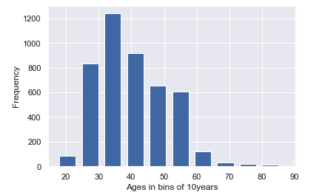
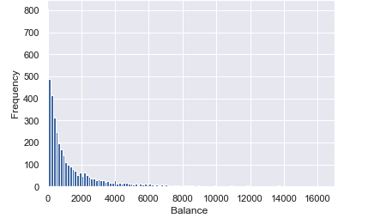
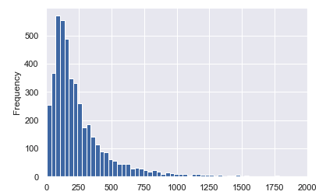
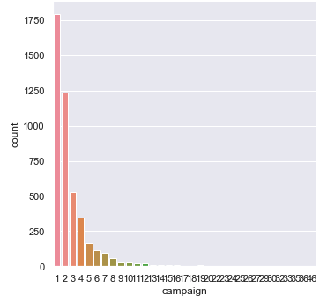
Histograms

Slide 4
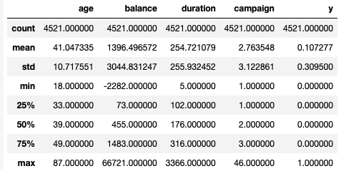
Summary Statstics

Slide 5
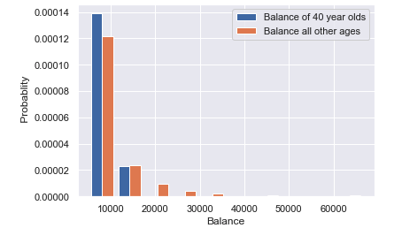
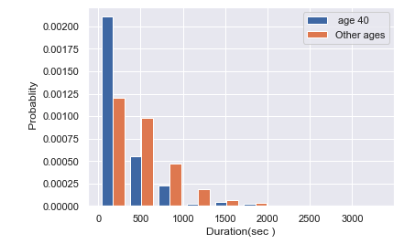
Comparison of those age 40 against all other age groups and the amount money they have in the bank.
Comparison of those age 40 against all other age groups and the amount of time they were engaged with a campaign.

Slide 6
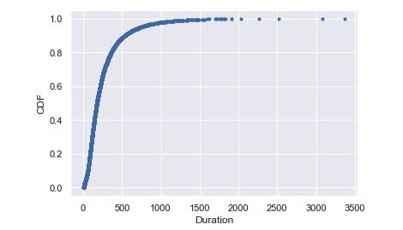
CDF of duration Showing the time spent engaging with the customer. this shows that the majority of the time was between 200sec and 1000sec. meaning that time of engagement could be a factor and possibly an area of improvement.

Slide 7
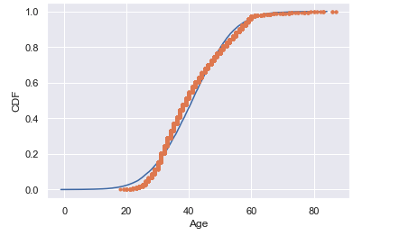
Analytical Distribution
What this shows is that the age of the clients at the back are almost normally distributed with slight variance around 40 and 60 years old. This would indicate that there is age representation that would fit what would be predict in society.

Slide 8
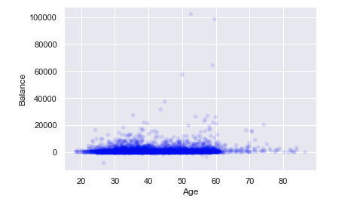
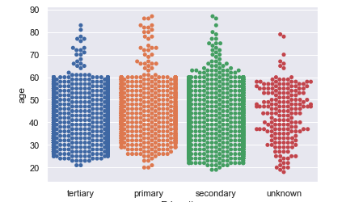
Scatter Plots
The first graph shows Age v Balance and is not very helpful since most people have a similar sized balance. The second although not a scatter plot but a bee swarm plot as it was categorical education v age. This showed that most people reported having at least a secondary education.

Slide 9
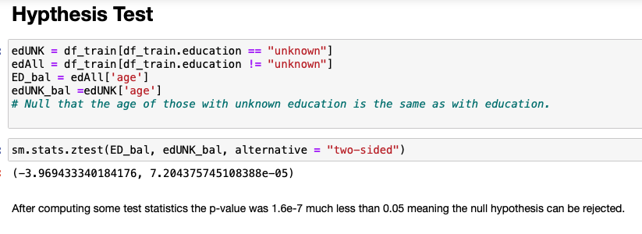

Slide 10
